Slide 1
STAT 885
FINAL PROJECT
Michael Grantham
David Nguyen
Jiaqi Chen

Slide 2
Objective
Place as high as we can on Kaggle leaderboard
Get the highest possible F1 score on test set

Slide 3
Overview of approach
Data inputs: TF-IDF weighted unigrams, bigrams (quanteda)
Classification: Elastic Net penalized logistic regression (glmnet)
Model tuning and evaluation: 10-fold CV (caret, MLmetrics)
Prediction on test set: F1 Score (MLmetrics, tidyverse)

Slide 4
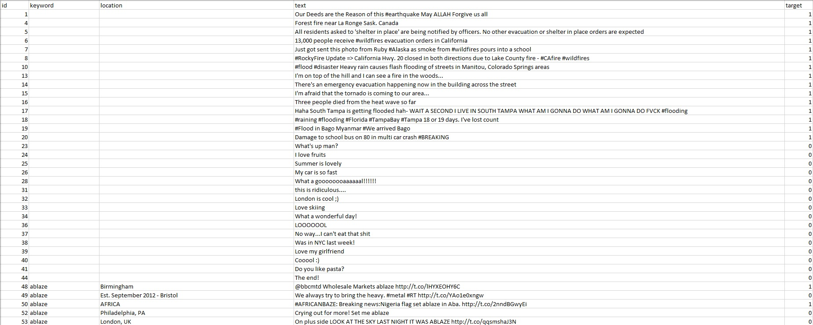
The data set - train (7613 observations)

Slide 5
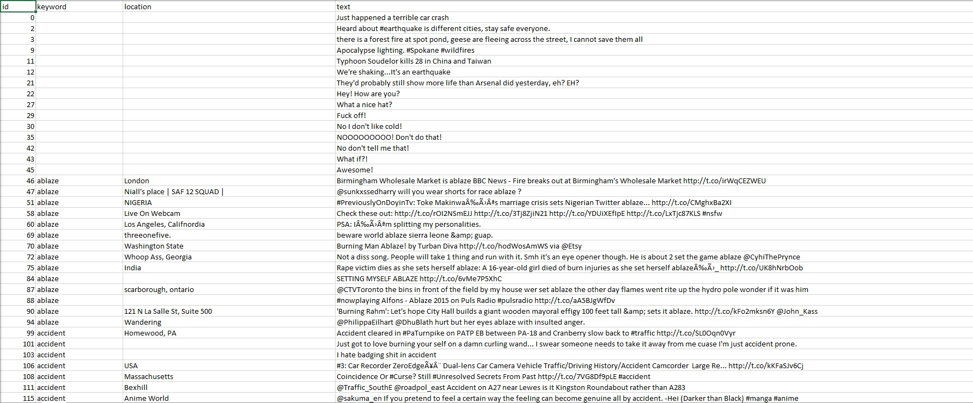
The data set - test (3263 observations)

Slide 6
Data processing
Used R quanteda package to:
Combine train and test tweets
Process tweets:
All lowercase
Remove url, punctuation, symbols, stopwords
Tokenize: unigram and bigrams
Quantization: created count vectors then applied tf-idf weighting
Result: DTM of 91,686 predictors with 99.98% sparsity

Slide 7
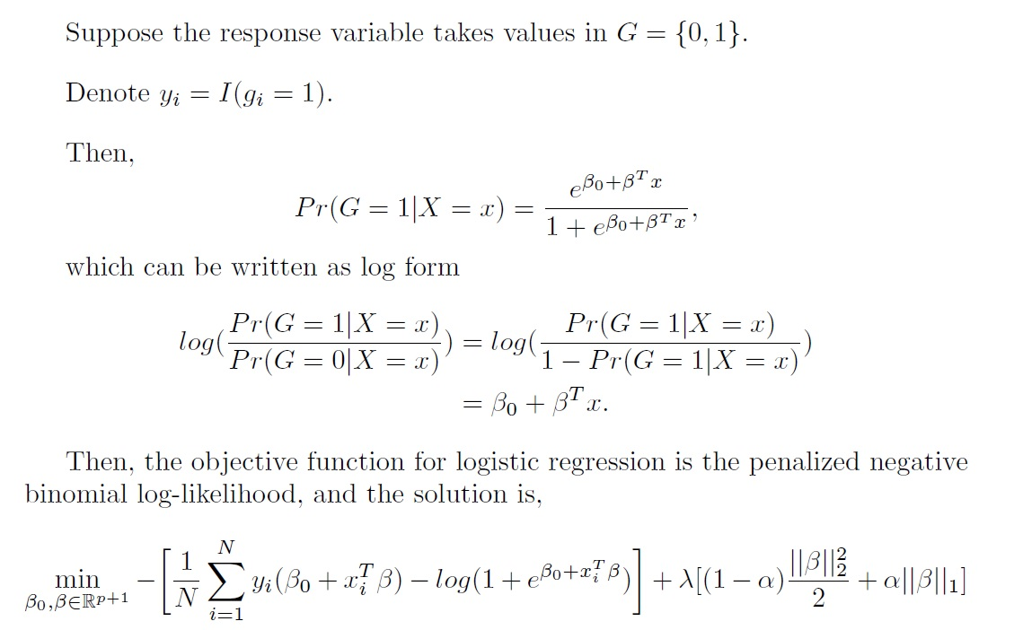
Method - generalized linear models (GLMs) with the elastic net penalty [1]

Slide 8
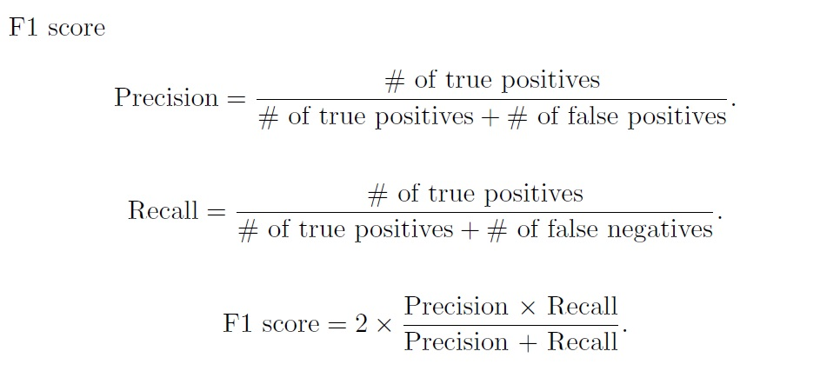
The F1 score [2]
The F1 score gives equal weight to Precision and Recall,
A model will obtain a high F1 score if both Precision and Recall are high;
A model will obtain a low F1 score if both Precision and Recall are low;
A model will obtain a medium F1 score if one of Precision and Recall is low and the other is high.

Slide 9
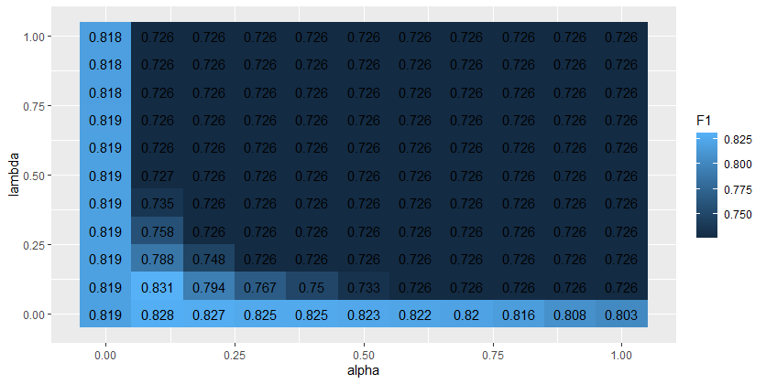
Cross validation procedure
Memory Problem–cannot search over grid which is too large
Search alpha x lambda grid from 0 to 1 by .1
Find that .1 is best for both alpha and lambda
Iteratively search smaller grids, arriving at the best alpha and lambda: Alpha: .087 Lambda: .086

Slide 10
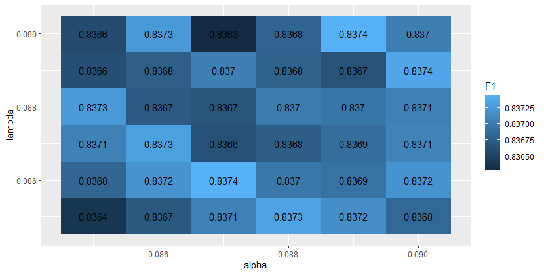
Cross validation results
Best EN mixing parameter (ɑ): 0.087
“Ridge-regression” like
Best shrinkage parameter (λ): 0.086
Selects 5% of all terms
Estimated prediction error (10-fold CV):
0.8375 (SE: 0.00827)

Slide 11
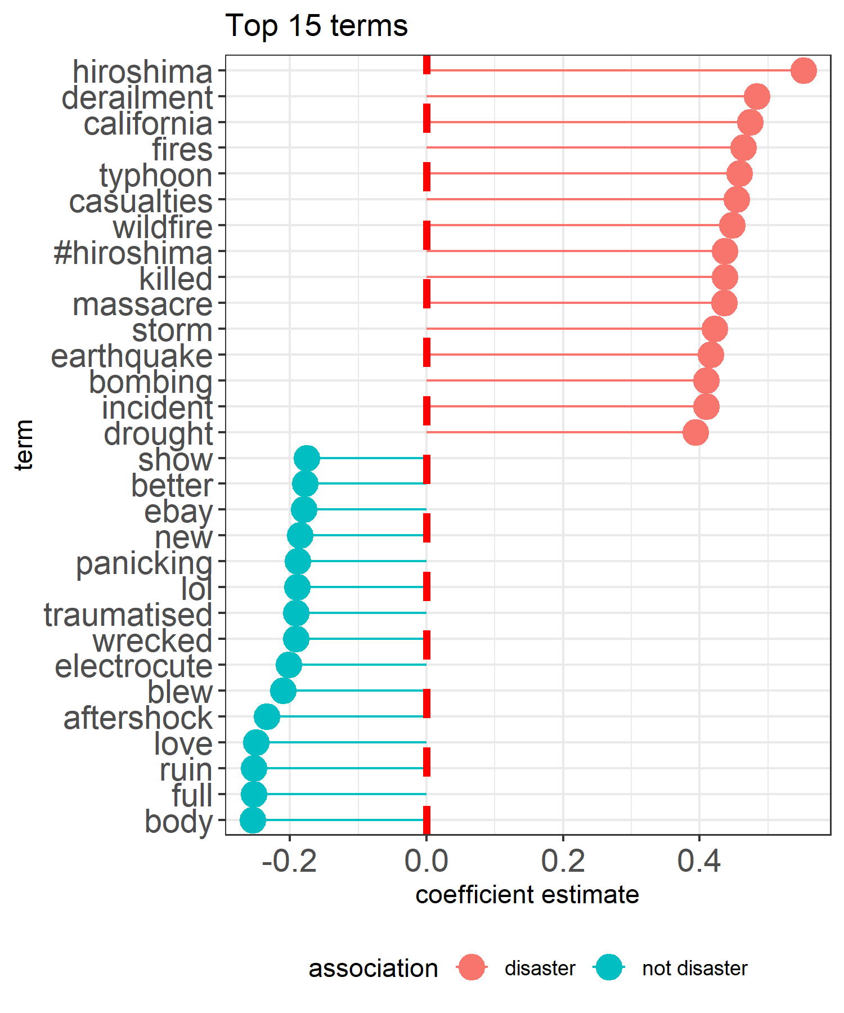
Important terms
4,705 selected terms out of 91,686
Non-disaster (𝛽<0): 421 terms
Disaster (𝛽>0): 4284 terms
No clear cut-off in importance among selected terms

Slide 12
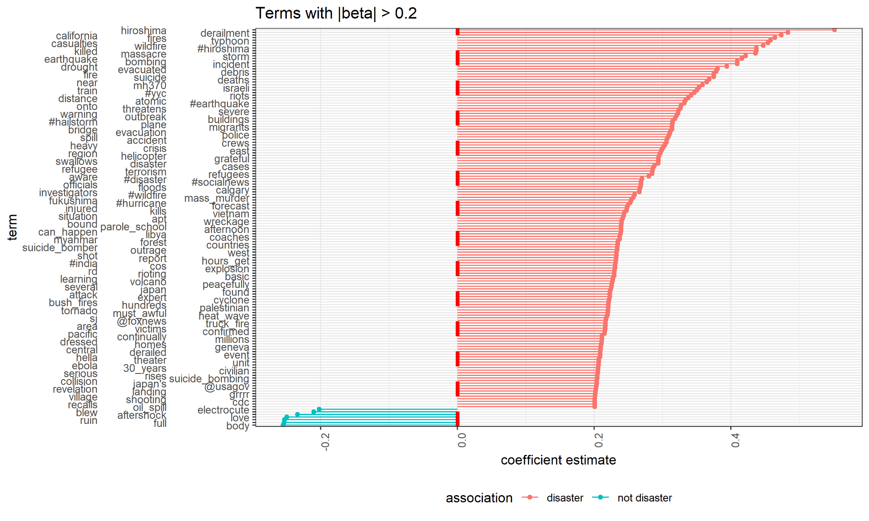

Slide 13
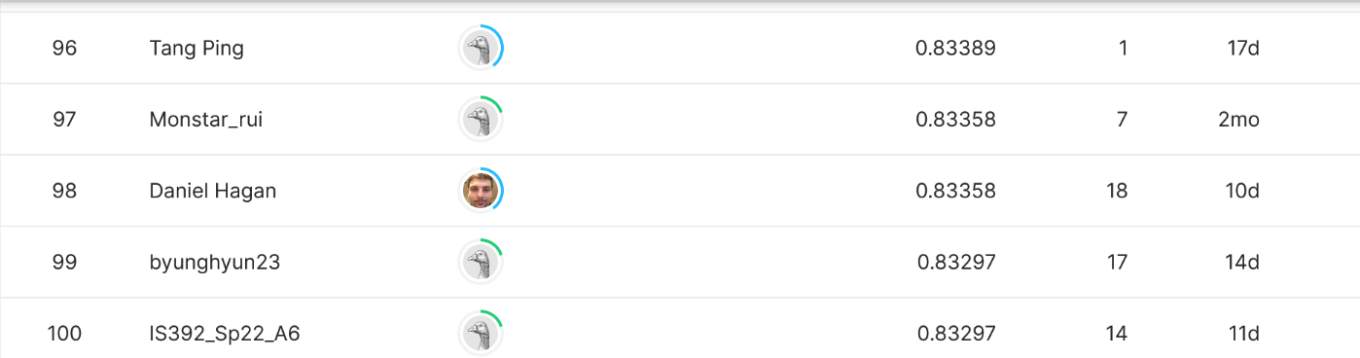
Performance on test set
Evaluate best model on test data with target: https://www.kaggle.com/code/szelee/a-real-disaster-leaked-label/data
F1 Score: 0.8337 → 97th place!!! (70th if we ignore perfect scores)

Slide 14
Reference
[1] Trevor Hastie, Junyang Qian, Kenneth Tay, An Introduction to glmnet, https://glmnet.stanford.edu/articles/glmnet.html.
[2] Joos Korstanje, The F1 score, https://towardsdatascience.com/the-f1-score-bec2bbc38aa6.

Slide 15
Thank you for listening!
Any questions?

